Slide 2

Placenta Examination
Prepared by:
Dr :Mona Al –Deeb
Clinical demonistrator in gynecological and obstetrics nursing

Slide 3

The objectives
Identify the size, shape, consistency and completeness of the placenta.
Determine the presence of accessory lobes, placental infarcts, haemorrhage and tumours.
Assess the umbilical cord for length, insertion, number of vessels, thrombosis, knots and the presence of wharton's jelly.
Evaluate the colour and the odour of the fetal membranes

Slide 4
The clinical characteristics of normal placenta:
Diameter: 22 cm at term.
Thickness: 2 to 2.5 cm.
Weight: 470 g (1 Ib).
The Maternal surface: Dark red in colour, it should be divided in cotyledons. The structure should be complete, with no missing cotyledons.

Slide 5
The Fetal surface of the placenta should be shiny, gray and translucent enough to see the colour of the underlying villous tissues.
The umbilical cord
length: 55 to 60 cm at term
Diameter: 2 to 2.5 cm
        The structure should have 2 arteries and 1 vein.
        Normal cord contains Wharton's Jelly.
        .

Slide 6
Procedures
Rational | Steps
To prevent retention of placenta or membrane parts | Delivery of the placenta: 1-As the placenta delivers, hold it in both hands and gently turn it until the membranes are twisted
 | 2-Slowly pull to complete the delivery. Move membranes up and down until they deliver.
To remove any remaining pieces of membrane. | 3- If the membranes tear, gently examine the upper vagina and cervix wearing sterile gloves and use a sponge forceps.

Slide 7
Examining the placenta : 4- Hold the placenta in the palms of the hands, with maternal side facing upwards.
5- Check whether all of the lobules are present and fit together.
6-Hold the cord with one hand and allow the placenta and membranes to hang down.
6-Insert the other hand inside the membranes, with fingers spread out.

Slide 8
7-Inspect the membranes for completeness.
8-If membranes or placenta are not complete, take immediate action
9-Document the findings in the delivery room report

Slide 9

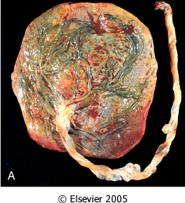
Placental infections derived from ascending and blood-borne routes. Acute chorioamnionitis. A, On gross examination, the placenta contains greenish opaque membranes
Downloaded from: Robbins & Cotran Pathologic Basis of Disease (on 5 March 2006 06:57 PM)
© 2005 Elsevier

Slide 10
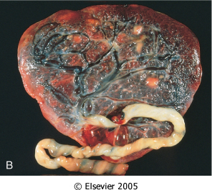
B, Normal term placenta (fetal surface) with umbilical cord.
Downloaded from: Robbins & Cotran Pathologic Basis of Disease (on 5 March 2006 06:57 PM)
© 2005 Elsevier

Slide 11



